Slide 1
Gérer les Structures de Stockage de Base de Données
Stockage des données des lignes de table sous la forme de
blocs
Créer et gérer les tablespaces
Déplacer et renommer les fichiers de dbase de données

Slide 2
Mode de stockage des données d'une table
Columns
Blocks
Table A
Table B
Rows
Segment
Segment
Table
Tablespace
Row piece
Extent
Notes:
When a table is created, a segment is created to hold its data. A tablespace contains a collection of segments.
Logically, a table contains rows of column values. A row is ultimately stored in a database block in the form of a row piece. It is called a row piece because, under some circumstances, the entire row may not be stored in one place. This happens when an inserted row is too large to fit into a single block (chained row) or when an update causes an existing row to outgrow the available free space of the current block (migrated row). Row pieces are also used when a table has more than 255 columns. In this case the pieces may be in the same block (intra-block chaining) or across multiple blocks.

Slide 3
Bloc de base de données : Contenu
En-tête de bloc
Croissance
Espace libre
Mode de stockage des données d'une table
Données des lignes
Notes:
Bloc de base de données : Contenu
En-tête de bloc : L'en-tête d'un bloc contient le type de segment (table ou index, par exemple), l'adresse du bloc, le répertoire des tables, le répertoire des lignes, et des espaces de transaction d'environ 23 octets chacun, utilisés lors de la modification des lignes du bloc. Il croît du haut vers le bas.
Données des lignes : Cet espace assure le stockage des données réelles des lignes contenues dans le bloc. Il augmente du bas vers le haut.
Espace disponible : Il se situe au milieu du bloc et permet l'extension des espaces d'en-tête et de données si nécessaire. Les données des lignes occupent l'espace libre à mesure que de nouvelles lignes sont insérées ou que des colonnes sont mises à jour avec des valeurs plus importantes dans les lignes existantes.
Exemples d'événements entraînant l'extension de l'en-tête :
Répertoires de lignes nécessitant davantage d'entrées de ligne
Besoin d'un nombre d'espaces de transaction supérieur à celui configuré initialement
A l'origine, l'espace libre d'un bloc est d'un seul tenant. Ensuite, cet espace peut être fragmenté en raison des suppressions et mises à jour effectuées. L'espace libre du bloc est fusionné par le serveur Oracle lorsque cela s'avère nécessaire.

Slide 4
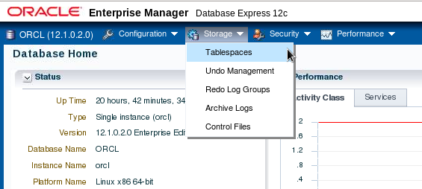
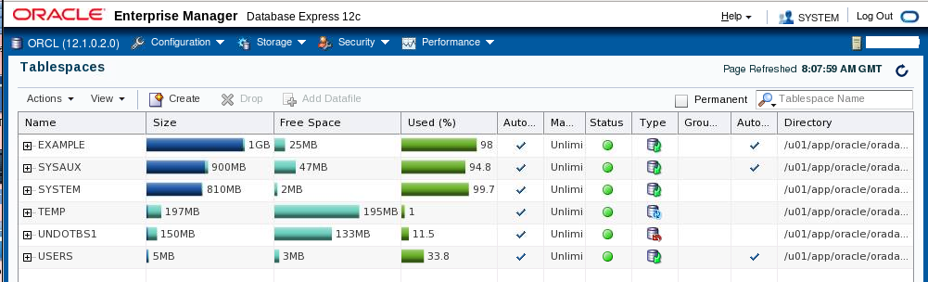
Explorer la structure de stockage
Notes:
You can easily view the storage structures of your database through Enterprise Manager Database Express. Detailed information about each structure can be obtained by selecting the structure in the Storage menu.

Slide 5
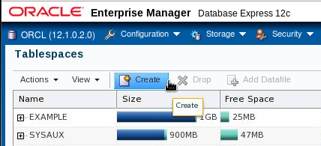
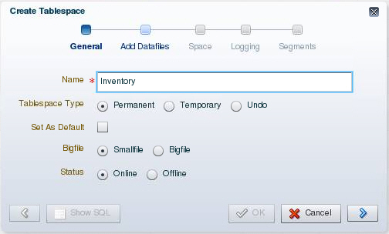
Créer un tablespace
Notes:
1. Expand the Storage menu, and then select Tablespaces.
2. Click Create.
3. Enter a name for the tablespace.
4. In the Tablespace Type field, select Permanent.
Permanent tablespaces store permanent database objects that are created by the system or users.
5. In the Bigfile field, select Smallfile. Bigfile tablespaces are used with extremely large databases, in which ASM or other logical volume managers support the striping or redundant array of independent disks (RAID) and dynamically extensible logical volumes.
6. In the Status field, select Online.
Online means that users can read and write to the tablespace after it is created. This is the default.
7. Click the blue arrow to add data files to the tablespace.

Slide 6
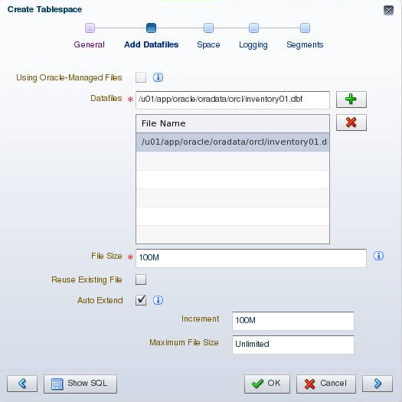
Créer un tablespace
Notes:
A tablespace must have at least one file.
8. On the Add Datafiles page, enter a file directory and file name for the data file.
9. Enter the desired file size.
10. Select “Auto Extend” to automatically extend the data file when it is full and specify an increment amount in the Increment field. This causes the data file to extend automatically each time it runs out of space. It is limited, of course, by the physical media on which it resides. Leave Maximum File Size as Unlimited or enter a maximum size.
11. Click the blue arrow to continue.

Slide 7
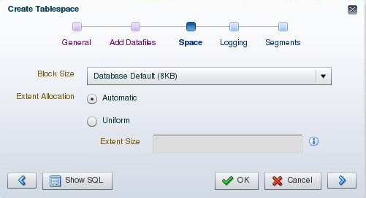
Créer un tablespace
Notes:
Block Size: This field shows the block size that is used for the tablespace being created.
Extent Allocation: The extents can be allocated in one of these two ways:
Automatic: Also called autoallocate, it specifies that the sizes of the extents in the tablespace are system managed. You cannot specify Automatic for a temporary tablespace.
Uniform: It specifies that the tablespace is managed with uniform extents of a size that you specify. The default size is 1 MB. All extents of temporary tablespaces are uniform. You cannot specify Uniform for an undo tablespace.

Slide 8
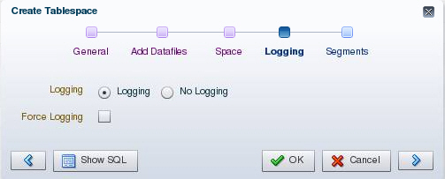
Créer un tablespace
Notes:
Logging: The LOGGING clause sets the default logging value for any segment created in the tablespace. Changes made to objects in the tablespace are written to the redo log. If logging is not enabled, any direct loads using SQL*Loader and direct load INSERT operations are not written to the redo log, and the objects are thus unrecoverable in the event of data loss. When an object is created without logging enabled, you must back up those objects if you want them to be recoverable. Choosing not to enable logging can have a significant impact on the ability to recover objects in the future. Use with caution. For more details about the logging clause, see the Oracle Database SQL Reference.
Note: If FORCE LOGGING mode is in effect for the database, it takes precedence over the tablespace logging setting. The database can be put into FORCE LOGGING mode at the time of database creation or after database creation using the ALTER DATABASE FORCE LOGGING command.

Slide 9
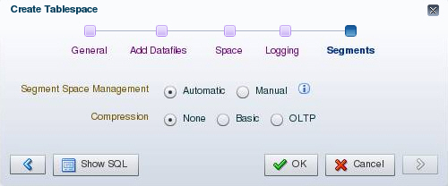
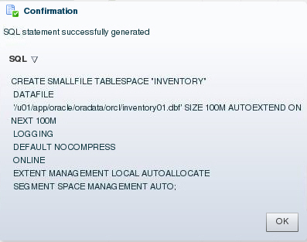
Créer un tablespace
Notes:
Segment Space Management: Segment space management can be specified as:
Automatic: The Oracle Database server uses bitmaps to manage the free space in segments. The bitmap describes the status of each data block in a segment with respect to the amount of space in the block that is available for inserting rows. As more or less space becomes available in a data block, the new state is reflected in the bitmap. With bitmaps, the Oracle database manages free space more automatically. As a result, this form of space management is called Automatic Segment Space Management (ASSM).
Manual: This specifies that you want to use free lists for managing free space in segments. Free lists are lists of data blocks that have space available for inserting rows. This form of managing space in segments is called manual segment space management because of the need to specify and tune the PCTUSED, FREELISTS, and FREELIST GROUPS storage parameters for schema objects created in the tablespace. This is supported for backward compatibility; it is recommended that you use ASSM.

Slide 10
Tablespaces créés par défaut
  EXAMPLE (optional)
  SYSAUX
  SYSTEM
  TEMP
  UNDOTBS1
  USERS
Notes:
The following tablespaces are created by default when you create an Oracle database:
SYSAUX: This is an auxiliary tablespace to the SYSTEM tablespace. Some components and products that used the SYSTEM tablespace or their own tablespaces in earlier releases of Oracle Database now use the SYSAUX tablespace.
SYSTEM: The SYSTEM tablespace is used by the Oracle server to manage the database. It contains the data dictionary and tables that contain administrative information about the database. These are all contained in the SYS schema and can be accessed only by the SYS user or other administrative users with the required privilege.
TEMP: Your temporary tablespace is used when you execute a SQL statement that requires the creation of temporary segments (such as a large sort or the creation of an index). Just as each user is assigned a default tablespace for storing created data objects, each user is assigned a temporary tablespace. The best practice is to define a default temporary tablespace for the database, which is assigned to all newly created users unless otherwise specified. In the preconfigured database, the TEMP tablespace is specified as the default temporary tablespace. This means that if no temporary tablespace is specified when the user account is created, Oracle Database assigns this tablespace to the user.

Slide 11
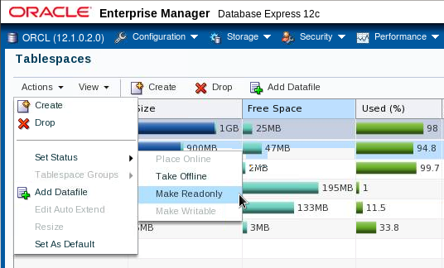
Modifier un Tablespace
Notes:
After you create a tablespace, you can alter it in several ways as the needs of your system change.
Changing the status: A tablespace can be in one of three different statuses or states. Any of the following three states may not be available because their availability depends on the type of tablespace.
Read Write: The tablespace is online and can be read from and written to.
Read Only: Specify read-only to place the tablespace in transition read-only mode. In this state, existing transactions can be completed (committed or rolled back), but no further data manipulation language (DML) operations are allowed on the objects in the tablespace. The tablespace is online while in the read-only state. You cannot make the SYSTEM or SYSAUX tablespaces read-only.
Note: The undo and temporary tablespaces cannot be made read-only.
Offline: You can take an online tablespace offline so that this portion of the database is temporarily unavailable for general use. The rest of the database is open and available for users to access data. When you take it offline, you can use the following options:
Normal: A tablespace can be taken offline normally if no error conditions exist for any of the data files of the tablespace. Oracle Database ensures that all data is written to disk by taking a checkpoint for all data files of the tablespace as it takes them offline.

Slide 12
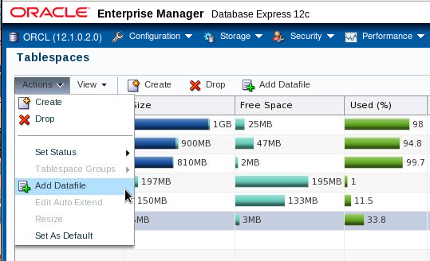
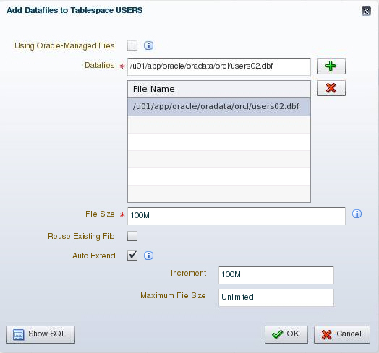
Ajouter un fichier de données à un tablespace
Notes:
Changing the size: You can add space to an existing tablespace by either adding data files to the tablespace or changing the size of an existing data file. To add a new data file to the tablespace, click Add. Then enter the information about the data file on the Add Datafile page.
Note: You cannot add additional data files to bigfile tablespaces.

Slide 13
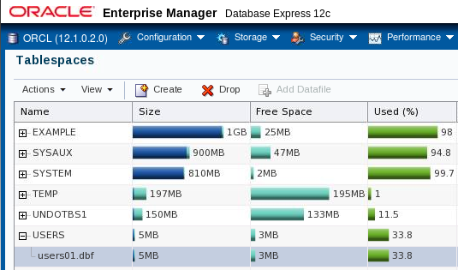
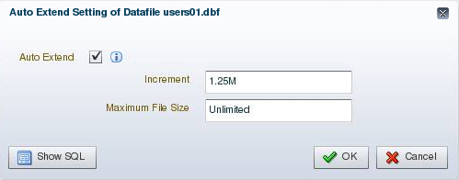
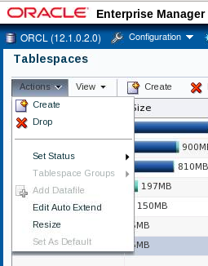
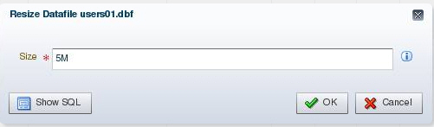
Modifier un fichier de données
Notes:
You can change the settings of a data file by expanding the tablespace on the Tablespaces page, selecting the data file, and selecting the appropriate task in the Actions menu.
To take a data file offline, select “Take Offline” from the “Set Status” menu.
To change the size of an existing data file:
1. Expand the tablespace on the Tablespaces page and select the data file.
2. Select Resize in the Actions menu.
3. Then, on the Edit Datafile page, you can change the size of the data file. You can make the tablespace either larger or smaller. However, you cannot make a data file smaller than the used space in the file; if you try to do so, you get the following error:
ORA-03297: file contains used data beyond requested RESIZE value

Slide 14
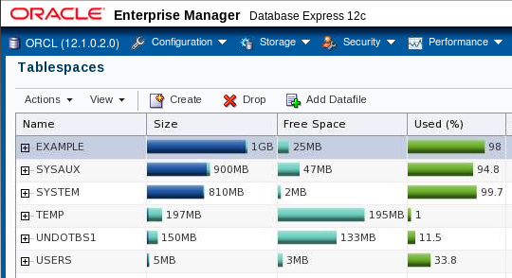
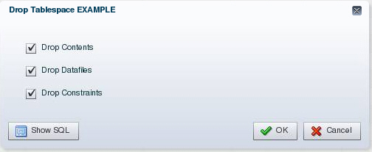
Supprimer un tablespace
Notes:
You can drop a tablespace and its contents (the segments contained in the tablespace) from the database if the tablespace and its contents are no longer required. You must have the DROP TABLESPACE system privilege to drop a tablespace.
When you drop a tablespace, the file pointers in the control file of the associated database are removed. If you are using Oracle Managed Files (OMF), the underlying operating system files are also removed. Otherwise, without OMF, you can optionally direct the Oracle server to delete the operating system files (data files) that constitute the dropped tablespace. If you do not direct the Oracle server to delete the data files at the same time that it deletes the tablespace, you must later use the appropriate commands of your operating system if you want them to be deleted.
You cannot drop a tablespace that contains active segments. For example, if a table in the tablespace is currently being used, or if the tablespace contains undo data that is needed to roll back uncommitted transactions, you cannot drop the tablespace. It is best to take the tablespace offline before dropping it.

Slide 15
Obtenir les informations sur les tablespaces
SQL> SELECT tablespace_name, status, contents, logging,
2 extent_management, allocation_type,
3 segment_space_management
4 FROM dba_tablespaces;
TABLESPACE_NAME STATUS CONTENTS LOGGING EXTENT_MAN ALLOCATIO SEGMEN
--------------- ------- --------- -------- ---------- --------- -----
SYSTEM ONLINE PERMANENT LOGGING LOCAL SYSTEM MANUAL
SYSAUX ONLINE PERMANENT LOGGING LOCAL SYSTEM AUTO
UNDOTBS1 ONLINE UNDO LOGGING LOCAL SYSTEM MANUAL
TEMP ONLINE TEMPORARY NOLOGGING LOCAL UNIFORM MANUAL
USERS ONLINE PERMANENT LOGGING LOCAL SYSTEM AUTO
EXAMPLE ONLINE PERMANENT NOLOGGING LOCAL SYSTEM AUTO
SQL> SELECT file_name, file_id, tablespace_name
2 FROM dba_data_files;
FILE_NAME FILE_ID TABLESPACE_NAME
------------------------------------------ ---------- ----------------
/u01/app/oracle/oradata/orcl/system01.dbf 1 SYSTEM
/u01/app/oracle/oradata/orcl/sysaux01.dbf 3 SYSAUX
/u01/app/oracle/oradata/orcl/users01.dbf 6 USERS
/u01/app/oracle/oradata/orcl/example01.dbf 2 EXAMPLE
/u01/app/oracle/oradata/orcl/undotbs01.dbf 4 UNDOTBS1
Notes:
Tablespace and data file information can also be obtained by querying the following:
Tablespace information:
DBA_TABLESPACES
V$TABLESPACE
Data file information:
DBA_DATA_FILES
V$DATAFILE
Temp file information:
DBA_TEMP_FILES
V$TEMPFILE

Slide 16
Oracle-Managed Files (OMF)
Permet de définir les opérations sur les fichiers en termes d'objets de base de données plutôt qu'en termes de noms de fichier.
Paramètre | Description
DB_CREATE_FILE_DEST | Définit l'emplacement du répertoire par défaut du système de fichiers destiné aux fichiers de données et aux fichiers temporaires
DB_CREATE_ONLINE_LOG_DEST_n | Indique l'emplacement des fichiers de journalisation et l'emplacement de création du fichier de contrôle
DB_RECOVERY_FILE_DEST | Emplacement par défaut de la zone de récupération rapide
Exemple :
SQL> ALTER SYSTEM SET DB_CREATE_FILE_DEST = '+DATA';
SQL> CREATE TABLESPACE tbs_1;
Notes:
Oracle-Managed Files (OMF)
Grâce à Oracle-Managed Files (OMF), vous n'avez plus besoin de gérer directement les fichiers du système d'exploitation d'une base de données Oracle. Vous définissez les opérations en termes d'objets de base de données plutôt qu'en termes de noms de fichier. La base utilise en interne les interfaces standard du système de fichiers afin de créer et de supprimer des fichiers, selon les besoins, pour les structures suivantes :
Tablespaces
Fichiers de journalisation
Fichiers de contrôle
Fichiers de journalisation archivés
Fichiers de suivi des modifications de bloc
Journaux Flashback
Sauvegardes RMAN
Une base de données peut être constituée de fichiers pris en charge par OMF et de fichiers non pris en charge. Le répertoire du système de fichiers indiqué par l'un ou l'autre des paramètres indiqués dans la diapositive doit exister. Il n'est pas créé par la base de données. Les droits définis sur ce répertoire doivent permettre à la base de créer des fichiers dans celui­ci.
Comme le montre l'exemple de la diapositive, lorsque le paramètre DB_CREATE_FILE_DEST est défini, la clause DATAFILE peut être omise dans une instruction CREATE TABLESPACE. Le fichier de données est créé à l'emplacement indiqué par DB_CREATE_FILE_DEST. Quand vous créez un tablespace de cette manière, des valeurs par défaut sont affectées à tous les paramètres.

Slide 17
Etendre la base de données
Vous pouvez étendre la base de données de différentes façons :
  En créant un tablespace
  En ajoutant un fichier de données à un tablespace smallfile existant
  En augmentant la taille d'un fichier de données
  En permettant la croissance dynamique d'un fichier de données
Base de données
Tablespace
SYSTEM
Tablespace
INVENTORY
Notes:
Etendre la base de données
Vous pouvez réaliser les activités indiquées dans la diapositive via Enterprise Manager ou par le biais d'instructions SQL. La taille de la base de données correspond à la somme de tous ses tablespaces.

Slide 18


Déplacer ou renommer un fichier de données en ligne
1
File System Storage
2
ASM Storage
MOVE
ONLINE
Tablespace HR: 3 data files
Tablespace HR: Diskgroup A
1
ASM Storage
2
File System Storage
MOVE
ONLINE
Tablespace APP: Diskgroup B
Tablespace APP: 3 data files
Notes:
You can rename or move an online data file from one kind of storage system to another while the database is opened and accessing the file.
Queries and DML and DDL operations can be performed while the data file is being moved, including the following:
SELECT statements against tables and partitions
Creation of tables and indexes
Rebuilding of indexes
Note: If objects are compressed while the data file is moved, the compression remains the same.

Slide 19
Déplacer ou renommer un fichier de données en ligne
  Déplacer un fichier de données en ligne:
  Déplacer un fichier du système de fichier Linux vers ASM:
  Renommer un fichier de données en ligne:
  ALTER DATABASE MOVE DATAFILE '/disk1/myexample01.dbf'
  TO '/disk2/myexample01.dbf';
  ALTER DATABASE MOVE DATAFILE '/disk1/myexample01.dbf'
  TO '+DiskGroup2' KEEP;
  ALTER DATABASE MOVE DATAFILE '/disk1/myexample1.dbf'
  TO '/disk1/myexample01.dbf';
Notes:
You do not have to shut down the database or take the data file offline while you move a data file to another location, disk, or storage system.
The TO clause can be omitted only when an Oracle-managed file is used. In this case, the DB_CREATE_FILE_DEST parameter should be set to indicate the new location.
If the REUSE option is specified, the existing file is overwritten.
If the KEEP clause is specified, the old file will be kept after the move operation. The KEEP clause is not allowed if the source file is an Oracle-managed file.
Use the V$SESSION_LONGOPS view to display ongoing online move operations. Each ongoing operation has one row. The state transition of a successful online move operation is usually NORMAL to COPYING to SUCCESS and finally to NORMAL.

